Slide 1
Needleman-Wunsch Algorithm
Team Members:
name
name

Slide 2
Background
The Needleman-Wunsch algorithm is a dynamic programming algorithm used in bioinformatics to align protein or nucleotide sequences. It was developed by Saul B. Needleman and Christian D. Wunsch in 1970. The algorithm finds the optimal alignment between two sequences by assigning scores to each possible alignment and selecting the alignment with the highest score.

Slide 3
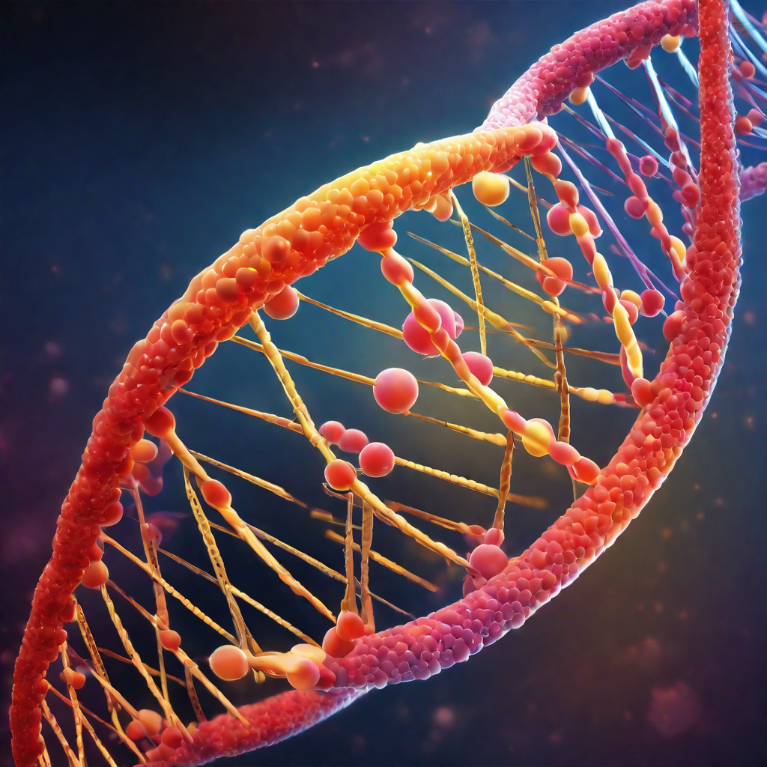
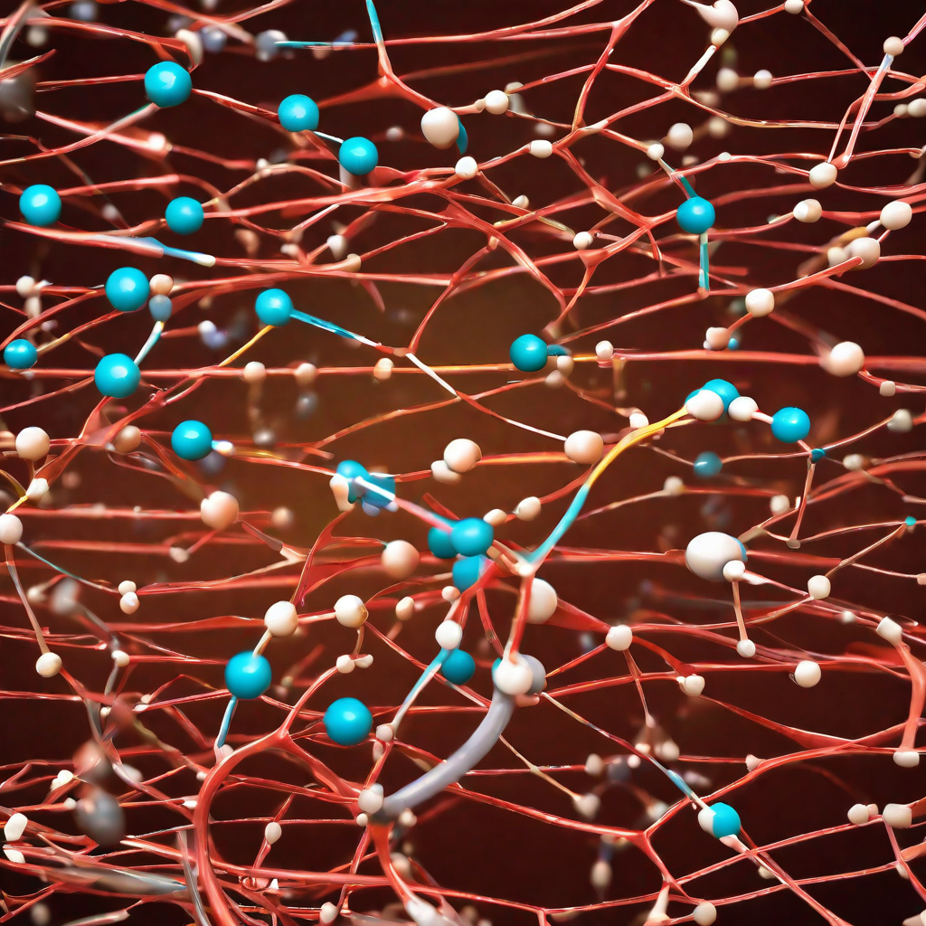
Purpose of the Algorithm
Needleman Wunsch Algorithm
Sequence Alignment
The Needleman Wunsch Algorithm is a dynamic programming algorithm used to find the optimal alignment of two sequences.
The algorithm is specifically designed to solve the problem of sequence alignment, which involves comparing and aligning two sequences, such as DNA or protein sequences, to identify similarities and differences.

Slide 4
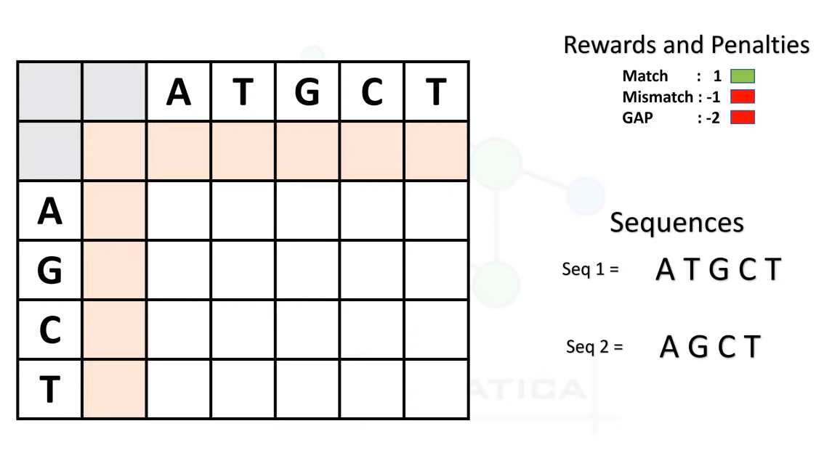
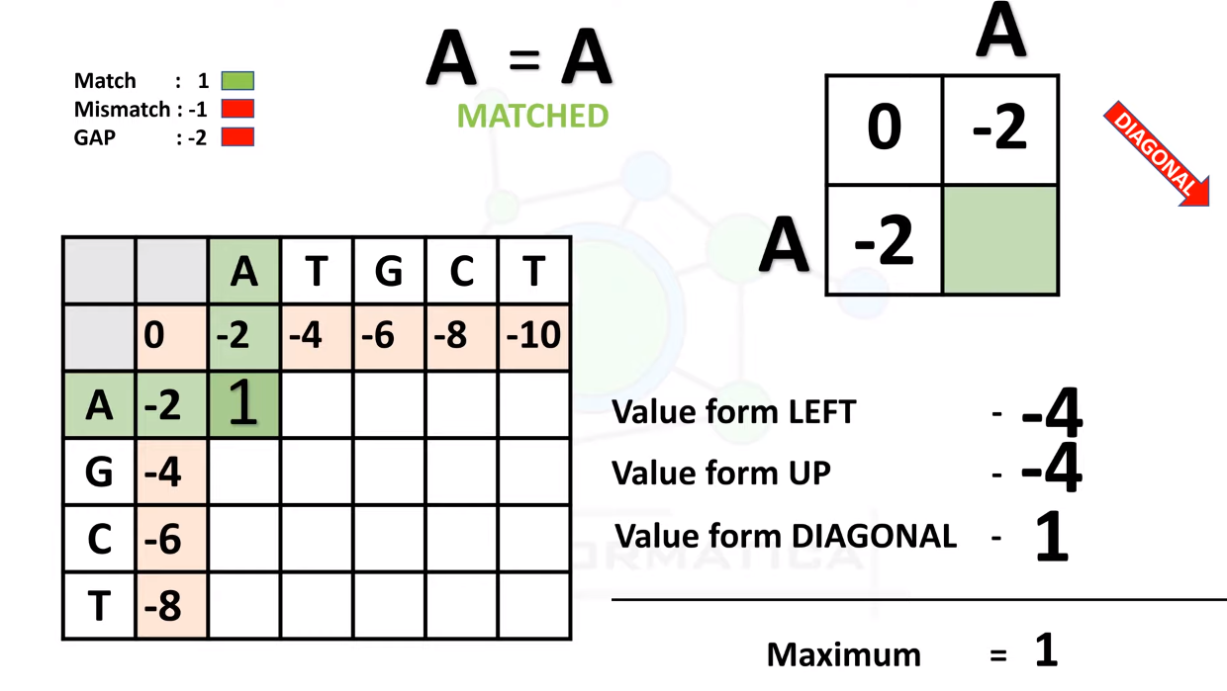
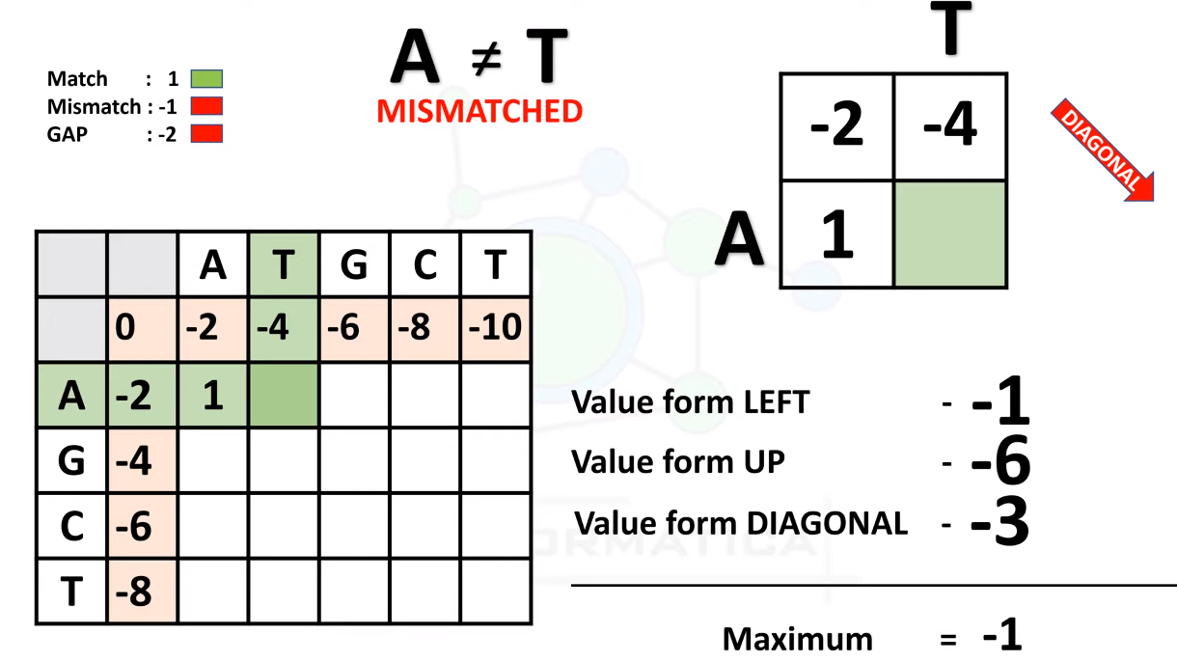
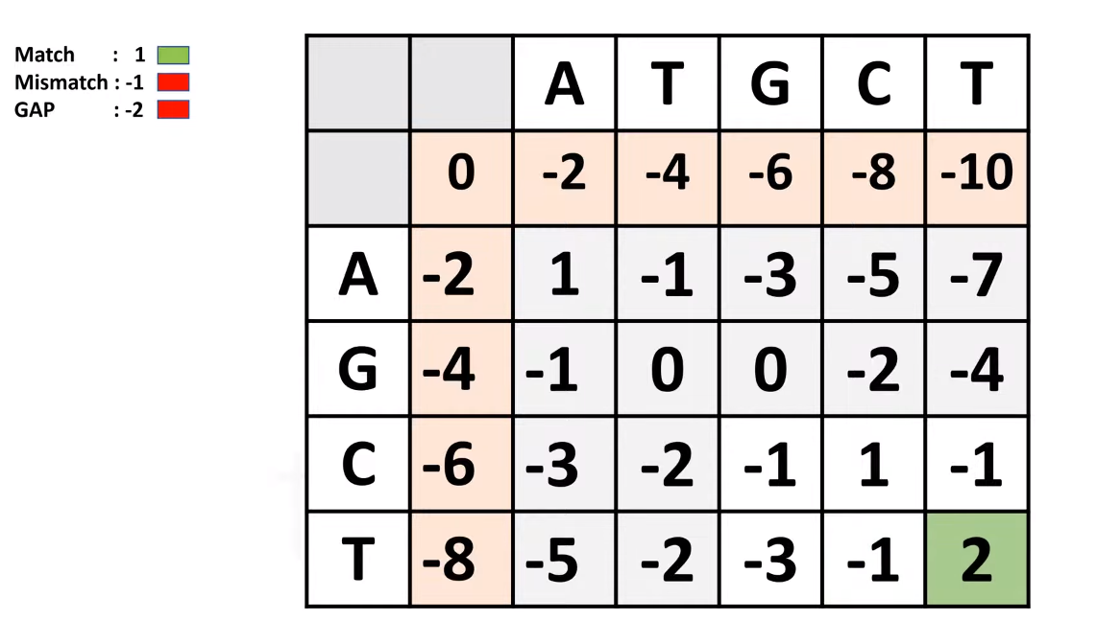
Explanation of Needleman Wunsch Algorithm

Slide 5
Pseudocode of Needleman Wunsch Algorithm
The Needleman-Wunsch algorithm is a dynamic programming algorithm used for pairwise sequence alignment. Here's a simplified pseudocode for the Needleman-Wunsch algorithm:
function needleman_wunsch(sequence1, sequence2):
# Initialize the scoring matrix
rows = length(sequence1) + 1
cols = length(sequence2) + 1
score_matrix = initialize_matrix(rows, cols)
# Fill in the scoring matrix
for i from 1 to rows:
for j from 1 to cols:
match_score = score_matrix[i-1][j-1] + match(sequence1[i-1], sequence2[j-1])
delete_score = score_matrix[i-1][j] + gap_penalty()
insert_score = score_matrix[i][j-1] + gap_penalty()
score_matrix[i][j] = max(match_score, delete_score, insert_score)
# Traceback to find the aligned sequences
alignment1, alignment2 = traceback(sequence1, sequence2, score_matrix)
return alignment1, alignment2
function initialize_matrix(rows, cols):
matrix = create_matrix(rows, cols)
# Initialize the first row
for j from 1 to cols:
matrix[0][j] = matrix[0][j-1] + gap_penalty()
# Initialize the first column
for i from 1 to rows:
matrix[i][0] = matrix[i-1][0] + gap_penalty()
return matrix
function traceback(sequence1, sequence2, score_matrix):
i = length(sequence1)
j = length(sequence2)
alignment1 = ""
alignment2 = ""
while i > 0 or j > 0:
if i > 0 and j > 0 and score_matrix[i][j] == score_matrix[i-1][j-1] + match(sequence1[i-1], sequence2[j-1]):
alignment1 = sequence1[i-1] + alignment1
alignment2 = sequence2[j-1] + alignment2
i = i - 1
j = j - 1
elif i > 0 and score_matrix[i][j] == score_matrix[i-1][j] + gap_penalty():
alignment1 = sequence1[i-1] + alignment1
alignment2 = "-" + alignment2
i = i - 1
else:
alignment1 = "-" + alignment1
alignment2 = sequence2[j-1] + alignment2
j = j - 1
return alignment1, alignment2
function match(symbol1, symbol2):
# Define the scoring for a match or mismatch
if symbol1 == symbol2:
return match_score
else:
return mismatch_score
function gap_penalty():
# Define the gap penalty
return -1
function create_matrix(rows, cols):
# Create a matrix filled with zeros
matrix = empty_matrix(rows, cols)
return matrix
function empty_matrix(rows, cols):
# Create a matrix filled with zeros
matrix = array of size rows x cols, initialized with zeros
return matrix

Slide 6


Application
DNA Sequencing
The Needleman Wunsch Algorithm is commonly used in DNA sequencing to align and compare DNA sequences, helping to identify similarities and differences between different organisms.
Protein Alignment
The Needleman Wunsch Algorithm is also used in protein alignment, which helps scientists understand the structure and function of proteins. By aligning protein sequences, researchers can identify similarities and differences, leading to insights about protein evolution and function.

Slide 7
Pros & Cons
The Needleman Wunsch Algorithm, a dynamic programming algorithm used in bioinformatics, has both advantages and disadvantages. Let's take a look at both sides:
 | Advantages | Disadvantages
01 | Optimal Alignment The Needleman Wunsch Algorithm guarantees finding the optimal alignment between two sequences, which can be very useful in biological research and analysis. | High Computational Complexity The algorithm has a high computational complexity, especially for large sequences, which can make it slow and resource-intensive.
02 | Global Alignment The algorithm performs global alignment, meaning it considers the entire sequences, which can be important for analyzing the overall similarity between sequences. | Lack of Flexibility The algorithm does not allow for gaps in the middle of sequences, which can limit its applicability in certain cases.
03 | Multiple Alignments The algorithm can handle multiple sequences alignments, which is useful for comparing and analyzing multiple sequences simultaneously. | Sensitivity to Parameter Choices The performance of the algorithm can be sensitive to the choice of scoring parameters, which may require careful tuning for optimal results.

Slide 8
Conclusion
The Needleman Wunsch Algorithm is a powerful tool for sequence alignment that has a wide range of applications in bioinformatics and computational biology. This allows researchers to compare and analyze sequences, identify similarities and differences, and gain insights into evolutionary relationships and functional properties.

Slide 9
THANK YOU

